Slide 1
Fraud Detection in Electricity and Gas Consumption
Monish Bangera
Malarvizhi S Pandian

Slide 2
Introduction
The Tunisian Company of Electricity and Gas (STEG) is a public and non-administrative company, it is responsible for delivering electricity and gas across Tunisia
Main problems faced by them is the imbalance in energy provided and energy consumed
Common reasons for this energy-loss are tampering with the meter, bypassing the meter by splicing the pipes
STEG suffered tremendous losses in the order of 200 million Tunisian Dinars

Slide 3
Project Goal
The aim of the project is to detect and recognize clients involved in any fraudulent activities based on their energy consumption and billing data
Fraud detection is treated as a classification problem where the supervised techniques are applied to the set of historic cases of fraud

Slide 4
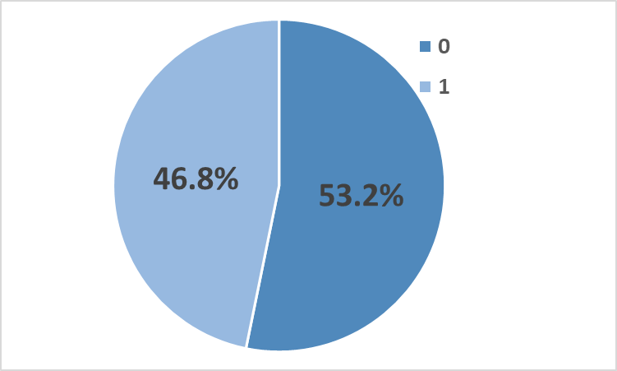
Variable Name | Description
Client_id | Unique id for the client
Invoice_date | Date of the invoice
Tarif_type | Type of tax
Counter_number | Counter number
Counter_statue | Takes up to 5 values such as working fine, not working, on hold status, ect
Counter_code | Counter code
Reading_remarque | Remarks given by STEG agent during client's visit
Counter_coefficient | An additional coefficient to be added when standard consumption is exceeded
Consommation_level_1 | Consumption level 1
Consommation_level_2 | Consumption level 2
Consommation_level_3 | Consumption level 3
Consommation_level_4 | Consumption level 4
Old_index | Old index
New_index | New index
Months_number | Month number
Counter_type | Type of counter
District | District where the client is
Client_catg | Category client belongs to
Region | Area where the client is
Creation_date | Date client joined
Target | fraud:1 , not fraud: 0
Data Description
Total no. of rows: 1465
Independent variable: 17
(Int: 14, Object:4, Float: 1)
Dependent variable: Target (Type: Int)
Categorical variables: 12
Continuous variables: 5

Slide 5
Data Preprocessing
Removed unimportant independent variables – features like client_id, old_index, new_index, invoice_date are removed
Remove null and zero values: There were no many rows with null or zero values
Create dummy variables: Categorical variables in training dataset are encoded using label encoder. Result has 57 variables excluding target
Feature scaling is used to normalize continuous variables using StandardScaler

Slide 6
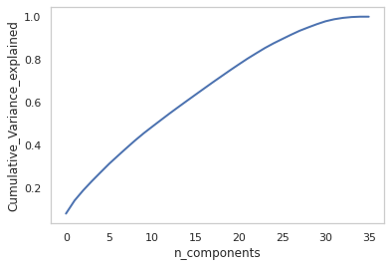

Modelling pipeline
Step 1. Principal Component Analysis(PCA) used for dimension reduction with minimized loss of information to improve model performance
Step 2.1. Logistic Regression algorithm determines the probability of an event using sigmoid function
Step 2.2. Decision Tree Classifier divides the dataset into subsets and the optimal split is selected using either information gain or entropy reduction
Step2.3. Random Forest Classifier builds multiple decision trees and merges them together to get a more accurate and stable prediction.

Slide 7
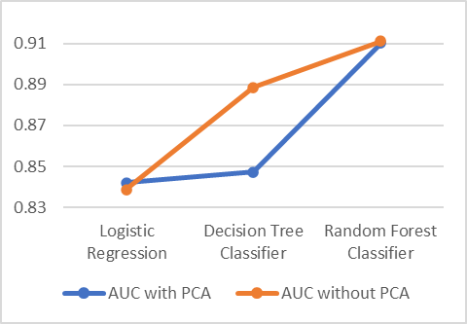
Evaluation
Algorithm | AUC before GridSearch | AUC after GridSearch | Best estimators
Logistic Regression | 0.838 | 0.841 | PCA: n_components=30(97.85%) LR: C=1000 max_iter=5000
Decision Tree | 0.888 | 0.847 | PCA: n_components=28(95%) DT: criterion='entropy max_depth=20, min_samples_leaf=10
Random Forest | 0.911 | 0.910 | PCA: n_components=19(75%) RF: max_depth=14 max_features=1

Slide 8
Conclusion
Overall Random Forest Classifier proved to be the best model in predicting fraudulent customers
Doing PCA did not affect the performance of Logistic Regression and Random Forest algorithms, as it only removed the redundant data
Whereas PCA seems to remove important information for Decision Tree classifier algorithm since the AUC score reduced by 4%
It is also proven most of the customers with higher energy consumption level happens to be the fraudulent customers.

